Slide 1
MICROSOFT MOVIE STUDIO
MARCH [2023]
PRESENTATION BY
DENNIS MWANZIA
NEW STUDIO

Slide 2
Overview
Outline
● Understanding Business Problem
● Data Understanding
● Analysis
● Findings
● Summary/Conclusions

Slide 3
Business Problem
Microsoft wants to start a new movie studio.
● What type of movies are best performing?
● Projected profitability based on key indicators.
● Generate recommendations!

Slide 4
Data
Sources used
Movie Budgets
IMDB
Movie reviews
● Performance metrics analyzed:
ROI = (World+ Domestic gross- Production cost) / Production cost
ROI vs Genre
ROI vs Runtime
ROI vs Rating
ROI vs Budget
ROI vs average vote
High Budget Movies
Language
Number of Movies
Studio
● Box Office Mojo Gross

Slide 5
Analysis
● combined data from 5 different sources
● Generated new performance metric, Return on Investment as dependent variable
● Analyzed ROI against independent variables
● Generated various plots to examine how these independent variables vary with ROI
● Generated recommendations from the insights gained.

Slide 6
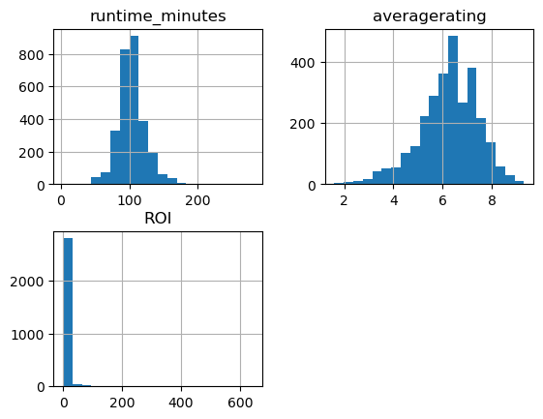
Visualize the distribution of runtime, ratings, and ROI using histograms
Notes:
Runtime and average rating distributions are normal

Slide 7

Results

Slide 8
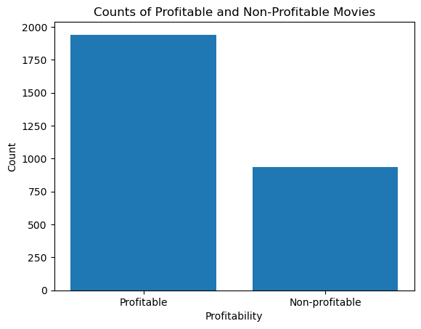
Is Movie Industry a profitable industry for investment?
Profitable & Non-Profitable Movies
Most movies had a positive ROI meaning the industry is highly profitable.
Among the more than 3000 movies analyzed, 65% of them had a positive ROI and hence this is an attractive industry for investment.

Slide 9
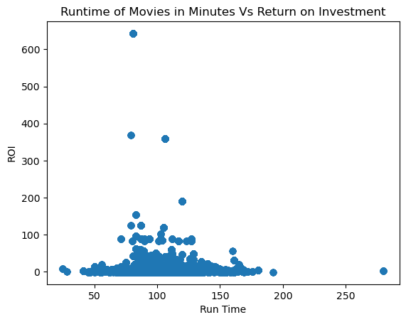
Insights
Bad performing Movies runtime<80 min
Short movies do not Perform well
Long movies > 100 mins are bad performing i.e low ROI
Optimal runtime is between 80 and 100 minutes

Slide 10
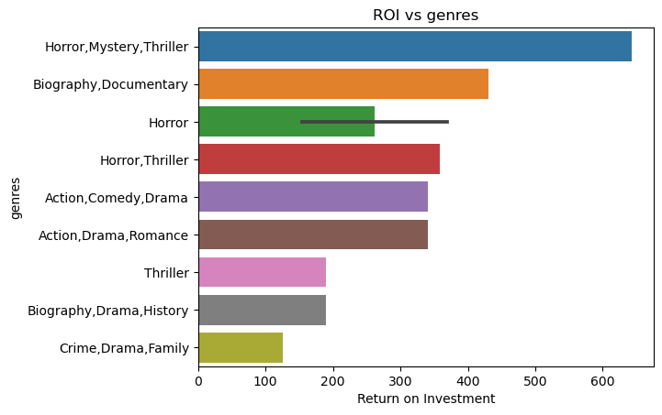
Insights
Horror, Mystery, Thriller Movies best performing
Biography, Documentary also highly preferred
Crime, Drama, Family least preferred

Slide 11
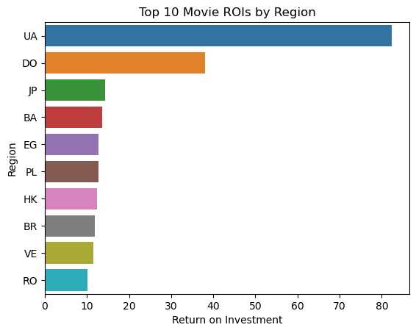
Movies with highest ROI were ones produced in Ukraine , Dominican Republic and Japan

Slide 12
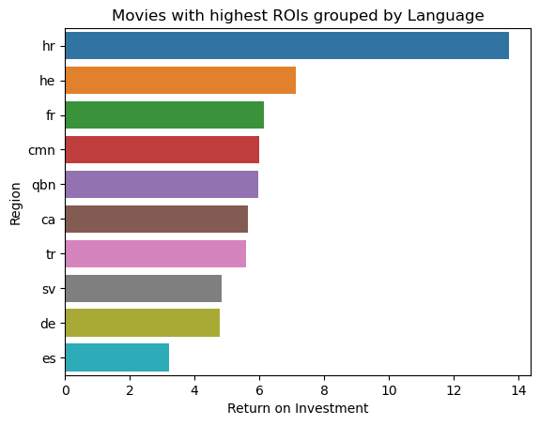
Movies produced in Croatian, Hebrew and French had the highest ROIs

Slide 13
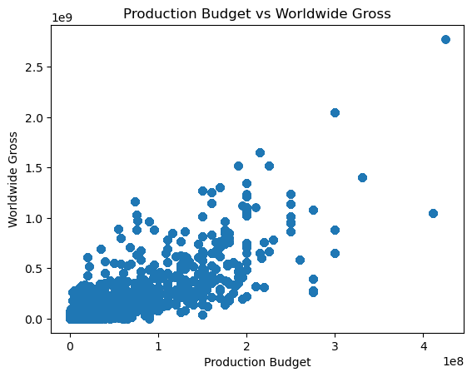
Production Budget vs Worldwide Gross have strong positive correlation.
High production budget > High worldwide gross

Slide 14
Correlation between variables
 | runtime_minutes | averagerating | ROI
runtime_minutes | 1.000000 | 0.203768 | -0.028707
averagerating | 0.203768 | 1.000000 | 0.007536
ROI | -0.028707 | 0.007536 | 1.000000

Slide 15
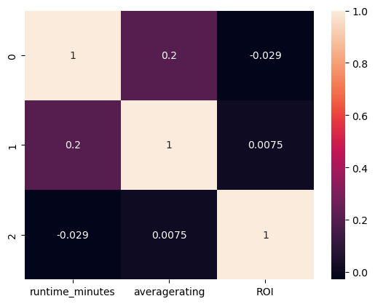
The darker shades indicate higher correlation values, while the lighter shades indicate lower correlation values
Notes:
From this heatmap, we can see that there is a weak positive correlation between runtime_minutes and averagerating, and a weak negative correlation between runtime_minutes and ROI. There is also a very weak positive correlation between averagerating and ROI.

Slide 16
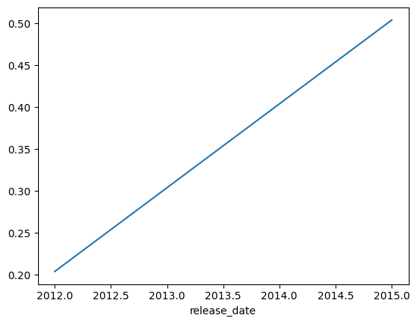
Movie Average Rating Over time

Slide 17
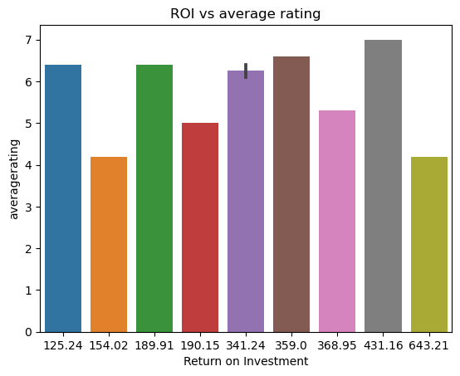
Highly rated movies > 5 perform better
Rating below implies low ROI

Slide 18
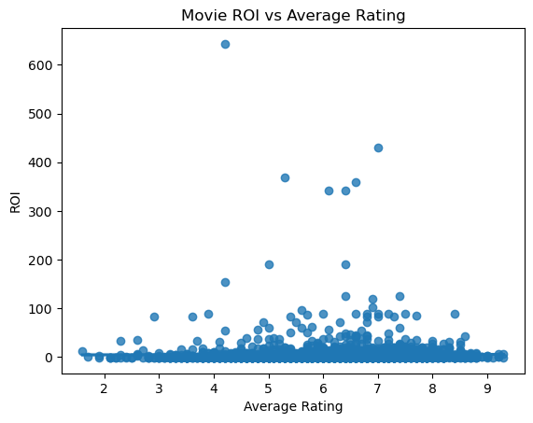
No strong correlation between average rating and ROI
Notes:
we can see that there is no strong correlation between average rating and ROI. There are some movies with high ROI and high average rating, but there are also some movies with low ROI and high average rating, as well as movies with high ROI and low average rating.

Slide 19
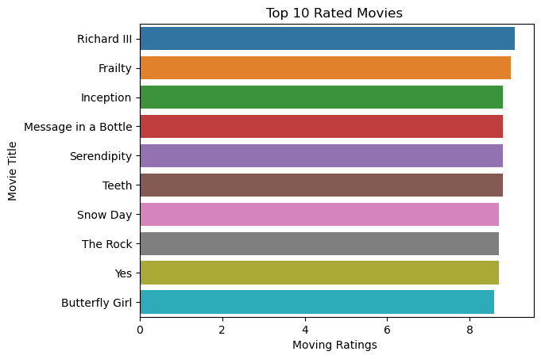

Slide 20
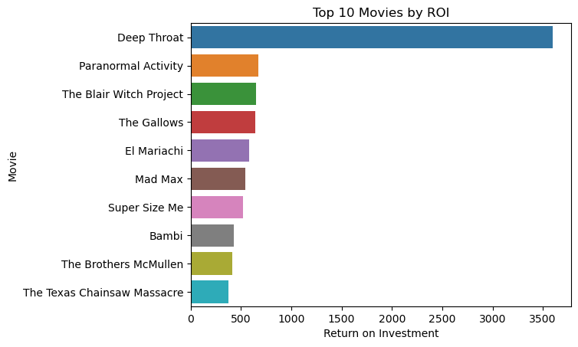
Top 10 Movies by ROI
Insights
Deep Throat is best Performing Movie followed by Paranormal Activity
The Texas chainsaw Massacre closes list of top 10 movies
Deep Throat outperforms the rest by more than 7 times, implying it had low budget but huge gross

Slide 21
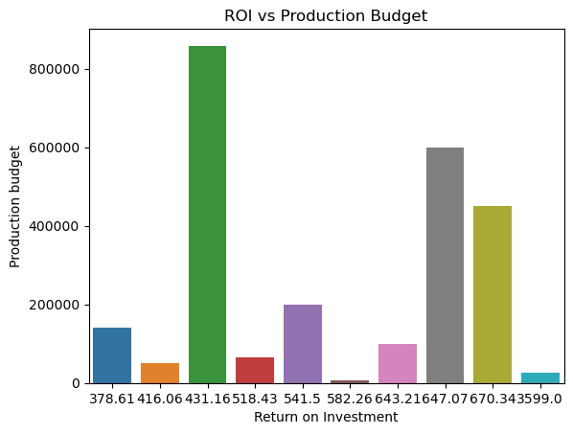
ROI vs Production budget for top 10 movies

Slide 22
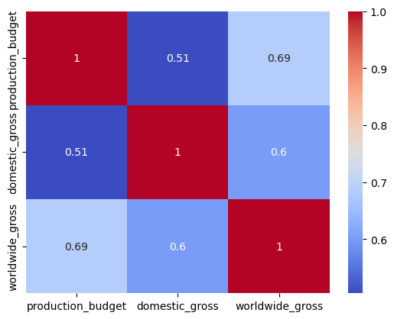
Notes:
A heat map to visualize the relationship between the production budget, domestic gross, and worldwide gross of the top 10 movies. Different colors to represent the values and plot the movies on the y-axis and the different variables on the x-axis.

Slide 23
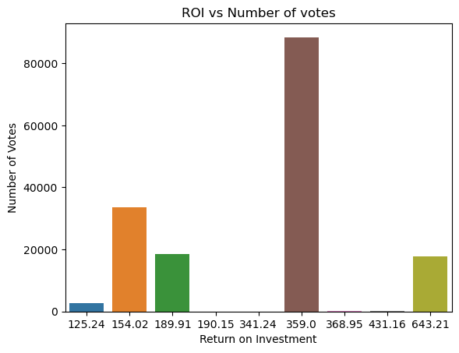
Movies with high number of votes
Have high ROI

Slide 24
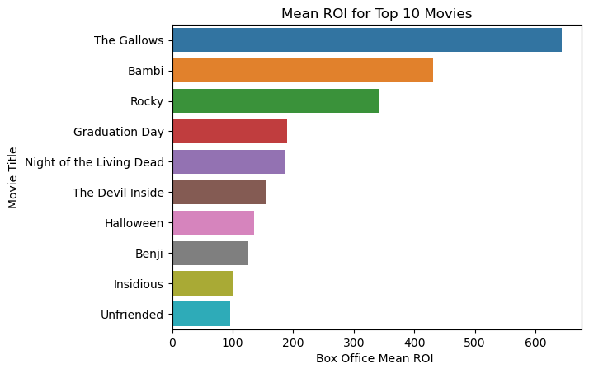
The Gallows" has the highest earnings by far, followed by "Bambi" and "Rocky".

Slide 25
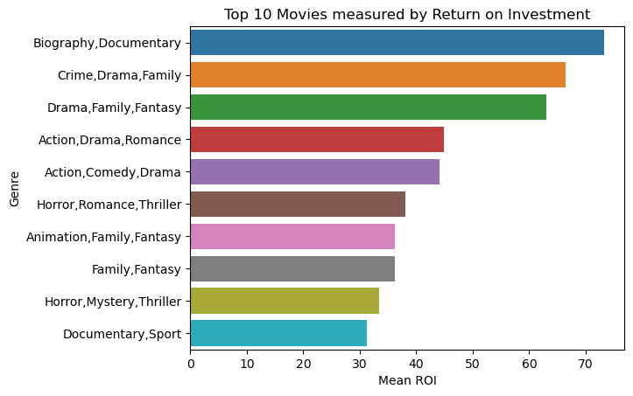
Movie Genre vs Mean ROI

Slide 26
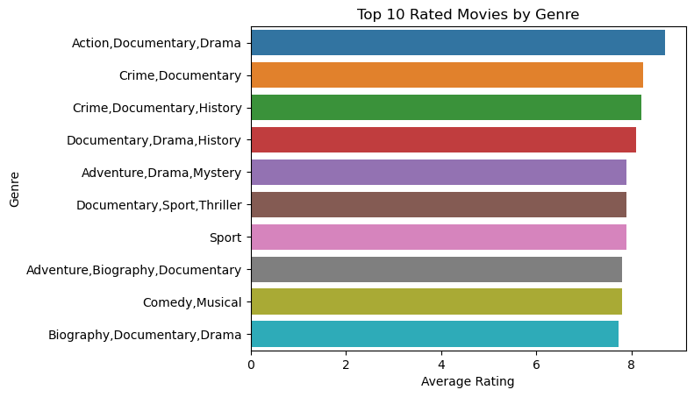

Slide 27
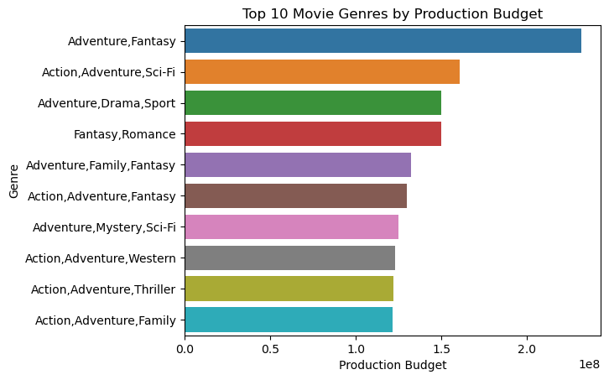

Slide 28
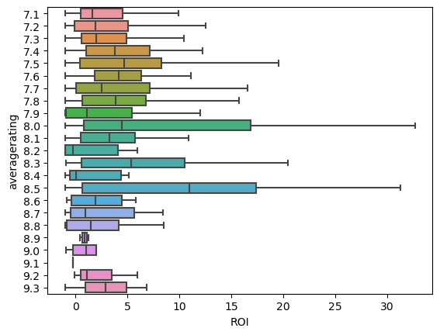
Highly Rated Movies Box Plot

Slide 29
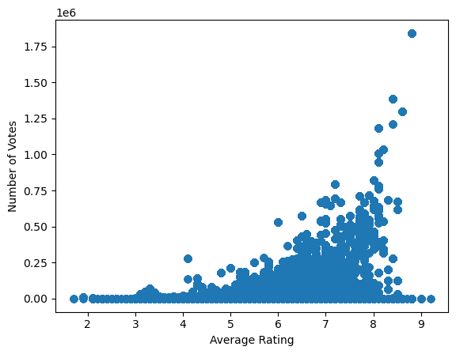
Correlation coefficient between numvotes and averagerating: 0.5124943038145994
Average rating influences the number of votes

Slide 30
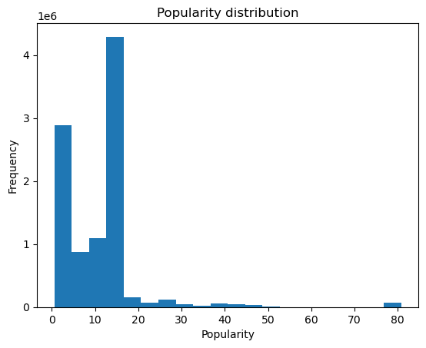

Slide 31
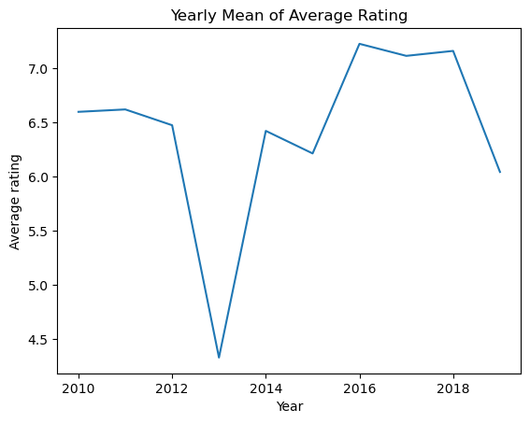

Slide 32
Recommendations
Analyzed: runtime, genre, TMDB average vote, language, region
Runtime between 80 and 100 minutes.
Genre: Horror, Mystery, Thriller , Biography or Documentaries
Best ROI by Region:
Ukraine , Dominican Republic and Japan
Best ROI by Language: Croatian, Hebrew and French
Profitability: Most Movies were profitable hence highly attractive industry.

Slide 33
conclusions
○ Make a movie that is either long or short, but medium length
● Pick Genre that suits budget and length:
● Further Research
○ We can examine how directors, writers, actors within a certain genre and budget affect Performance.

Slide 34

Thank you
Email : dennomwanzia@gmail.com
Github: https://github.com/DennisMwanzia
LinkedIn: https://www.linkedin.com/in/dennis-mwanzia-271412232/

Slide 35
MOVIE Fun
MARCH [2023]
THANK YOU
MICROSOFT NEW MOVIE STUDIO

